Slide 1
ORB and Pairs Trading Algorithm
Zachary Cheng, Farruh Mavlonov, Abhinav Rajaram, Cameron Nguyen
12 May 2023
Notes:
Introduce ourselves

Slide 2
Project Aim
Given minute-by-minute historical price and volume data for 3 ETFs and 16 underlying stocks from 9/4/2021 to 29-12-2022
Work in teams of 4 to develop a trading algorithm in Python to trade these products in the in-house Backtester
Present the findings in a report and presentation
Notes:
CAM:
Our team was given a dataset containing historical stock prices and trading volumes for various stocks and ETFs, and our goal was to develop a trading algorithm that could use this data to make profitable trades.
However, after analysing the data, we realised that we didn't have enough information to make confident decisions about which individual stocks or ETFs to trade.
So instead, we decided to implement a technical trading strategy known as a "breakout" strategy.
This strategy involves identifying key levels of support and resistance for a stock or ETF and placing trades when the price "breaks out" beyond these levels, signaling a potential trend reversal or continuation.
After testing our breakout strategy on the historical data, we fine tuned the hyper parameters and indicators.
Overall, we were pleased with the results and felt that we had achieved our goal of developing a trading algorithm that could generate profits from historical stock price and volume data.
We also planned on using arbitrage

Slide 3
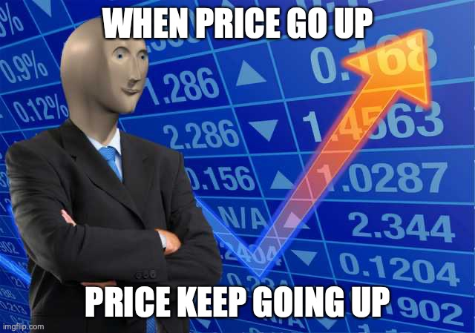
Breakout Strategy
What is a Breakout Strategy?
Momentum-based strategy
The support band is the lower band, representing buying pressure, preventing the price from falling further.
Resistance band is the higher band, representing selling pressure, preventing the price from rising further.
When the price action breaks out of support or resistance, enter a trade
Two key components for implementing breakout
Identify key levels of support & resistance
Confirm the breakout
Notes:
FARRUH:
A breakout strategy is a momentum-based trading strategy that aims to profit from the continuation of a price trend.
The basic idea behind a breakout strategy is that when the price breaks out of a key level of support or resistance, it will continue to move in the same direction, creating a trading opportunity.
There are two key components to implementing a breakout strategy: identifying key levels of support and resistance, and confirming the breakout.
Support levels are price levels where buying pressure is strong enough to prevent the price from falling further, while resistance levels are price levels where selling pressure is strong enough to prevent the price from rising further.
Once key support and resistance levels have been identified, traders wait for the price action to break out of these levels before entering a trade in the direction of the breakout.
One key risk of a breakout strategy is that false breakouts can occur, where the price breaks through a support or resistance level but then quickly retraces. To mitigate this risk, it’s important to filter false breakouts by confirming a real breakout with increased volume
Overall, breakout strategies can be an effective way to profit from trending markets, but they require careful analysis and risk management to be successful.

Slide 4
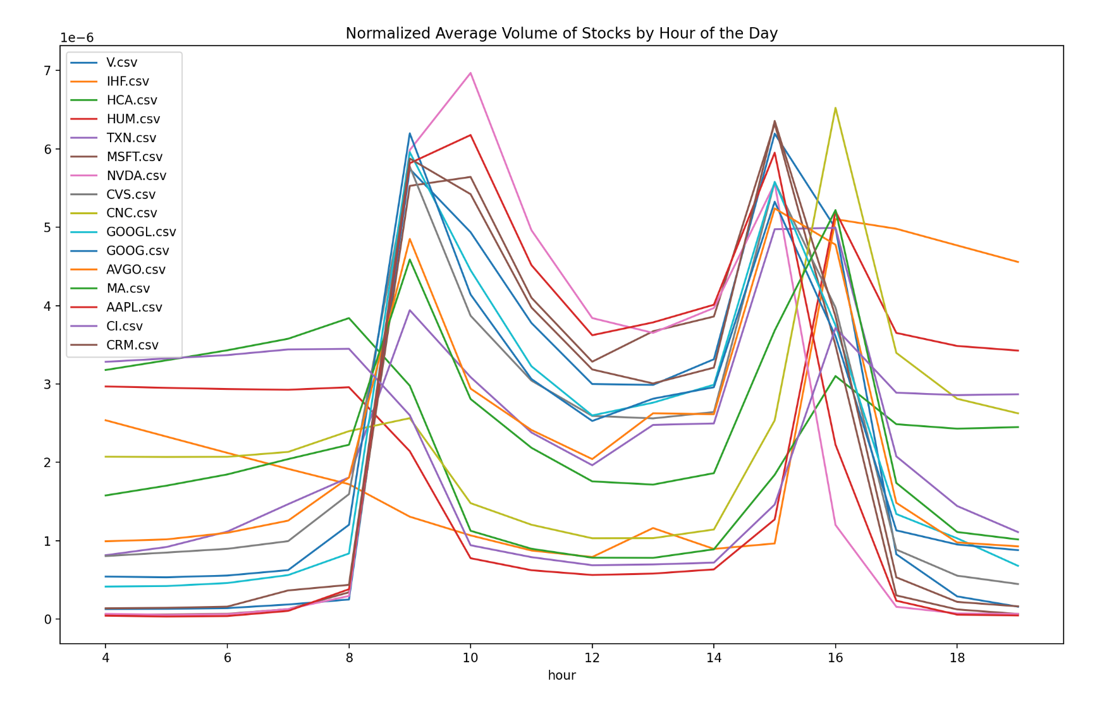
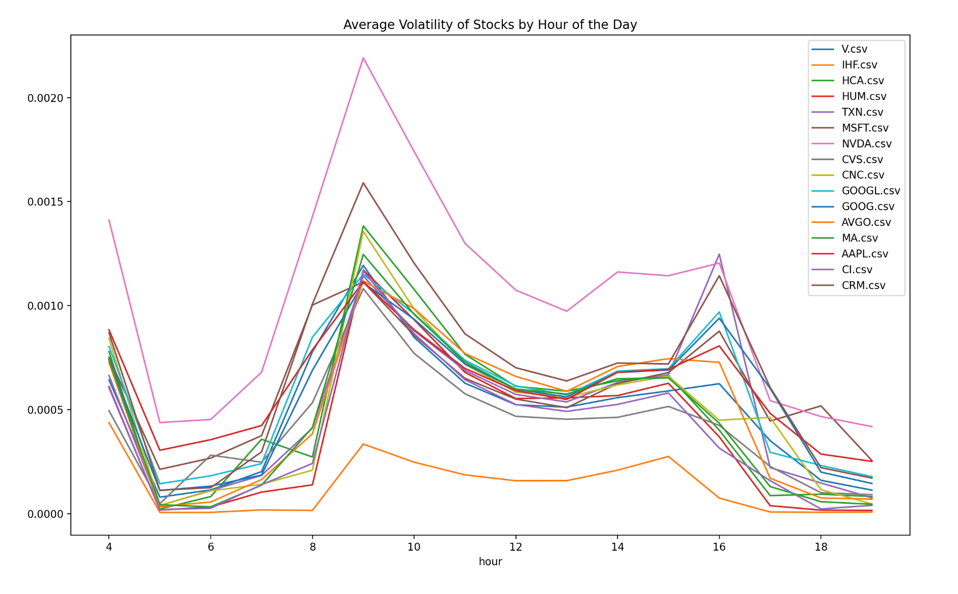
Opening Range Breakout
Opening Range Breakout (ORB) to determine support & resistance
Intraday trading strategy
The first N minutes of the day are significant in setting the market psychology for the rest of the day
At market open, price action adjusts to news & events that happen overnight
We use the high & low of the first N minutes as our support and resistance
Notes:
ZAC:
The opening minutes of the trading day are significant in setting the market psychology for the rest of the day, as price action adjusts to news and events that happened overnight.
We used the Opening Range Breakout (ORB) strategy to determine our support and resistance levels for the day.
The ORB strategy involves using the high and low of the first N minutes of trading as our support and resistance levels.
The idea behind the ORB strategy is that the opening range is significant in setting the tone for the day's trading, as market participants react to news and events.
If the price breaks above the opening range, it is a bullish signal, indicating that the price action is strong and likely to continue moving up.
If the price breaks below the opening range, it is a bearish signal, indicating that the price action is weak and likely to continue moving down.
To filter out noise and action near the support and resistance levels, we use a threshold above and below the opening range.
The period leading up to market close, known as "power hour," can be a time of increased trading volume and volatility as investors rush to close out positions before the end of the day.
Overall, using the ORB strategy can be an effective way to identify key support and resistance levels and make profitable trades based on market psychology and price action.

Slide 5
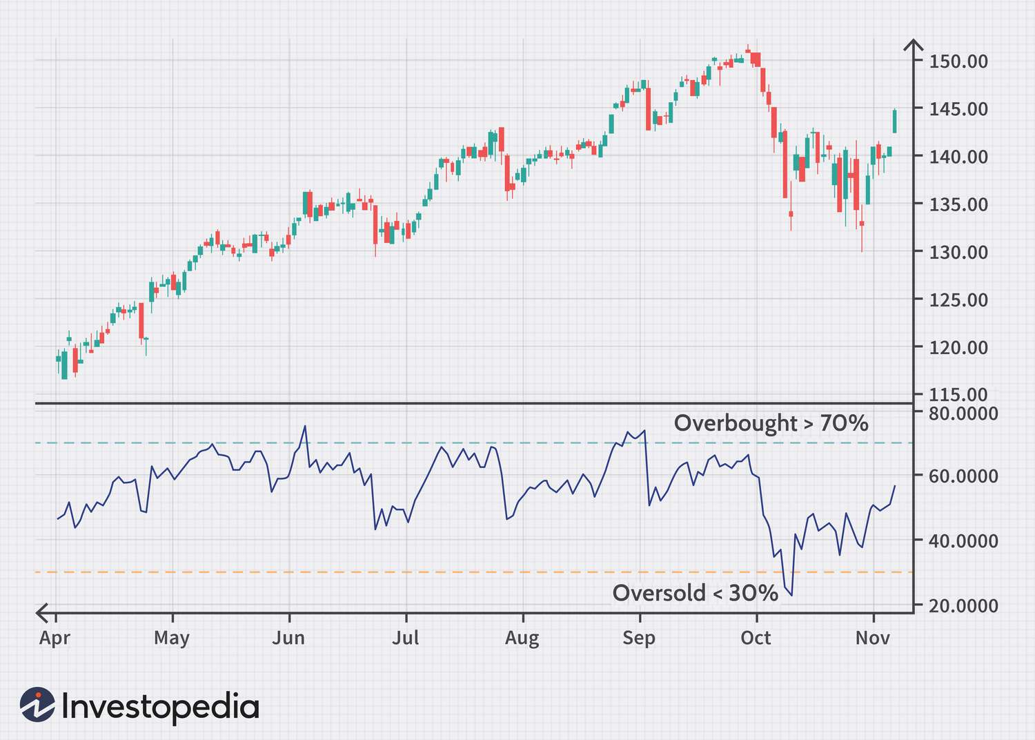
Confirming the Breakout
A breakout is price action that moves outside support or resistance with increased activity
We used the Relative Strength Index (RSI) to analyse the strength and momentum of an action’s price movement
RSI compares the average gain and losses of the asset’s prices over a period of time
Notes:
ABHINAV:
A breakout is a price action that moves outside of a support or resistance level with increased trading activity.
Breakouts are significant because they can indicate a potential trend reversal or continuation, and can create profitable trading opportunities.
To confirm a breakout, we used the Relative Strength Index (RSI), which is a technical indicator that measures the strength and momentum of an asset's price movement.
RSI compares the average gains and losses of the asset's prices over a period of time and produces a reading between 0 and 100.
An RSI reading above 70 indicates that the asset is overbought, while a reading below 30 indicates that the asset is oversold.
By using the RSI in conjunction with breakout analysis, we were able to confirm the strength and momentum of a breakout and make informed trading decisions.
It's important to note that false breakouts can occur, and using additional technical indicators and risk management techniques such as stop-loss orders can help minimize potential losses.

Slide 6
Exiting the Trade
Determine a threshold value for the RSI that signals an exit point, based on historical data and market conditions.
Monitor the RSI during the trade and exit the position once the RSI falls below the predetermined threshold.
Used a trailing stop loss in combination with the RSI threshold as an exit strategy to further minimize losses and maximize profits.
Notes:
CAM:
To use the RSI as an exit strategy, we first need to determine a threshold value that signals an exit point based on historical data and current market conditions.
This threshold value will depend on a variety of factors such as the volatility of the asset, the trading strategy being used, and the trader's risk tolerance.
Once the threshold value has been determined, traders should monitor the RSI during the trade and exit the position once the RSI falls below the threshold.
This can help prevent losses and protect profits by exiting the trade before the asset's price falls too far.
Traders can also use a trailing stop loss in combination with the RSI threshold as an exit strategy.
A trailing stop loss is a type of order that automatically adjusts the stop loss level as the price of the asset moves in the trader's favor.
By combining a trailing stop loss with the RSI threshold, traders can further minimize losses and maximize profits by allowing the trade to continue as long as the asset's price remains in an uptrend.
Overall, using the RSI as an exit strategy can be an effective way to protect profits and minimize losses, but it requires careful analysis and risk management to be successful.

Slide 7
Strategy Overview
Breakout strategy
Opening Range Breakout to determine levels of support and resistance
RSI to confirm the breakout
We chose to stick to a simple strategy we could understand
Hyperparameters
Notes:
FARRUH:
Our trading strategy used a simple and effective combination of the Opening Range Breakout and RSI indicators to determine support and resistance levels and confirm breakouts.
We chose to stick with a strategy that we could easily understand and implement, rather than using complex or advanced techniques.
Hyperparameters, such as moving average lengths and RSI thresholds, were carefully optimized through backtesting to ensure optimal performance.
Our strategy highlights the importance of simplicity, careful analysis, and risk management in generating profits in the stock market.

Slide 8

Example - APPL
Notes:
ZAC:
Go through the example

Slide 9
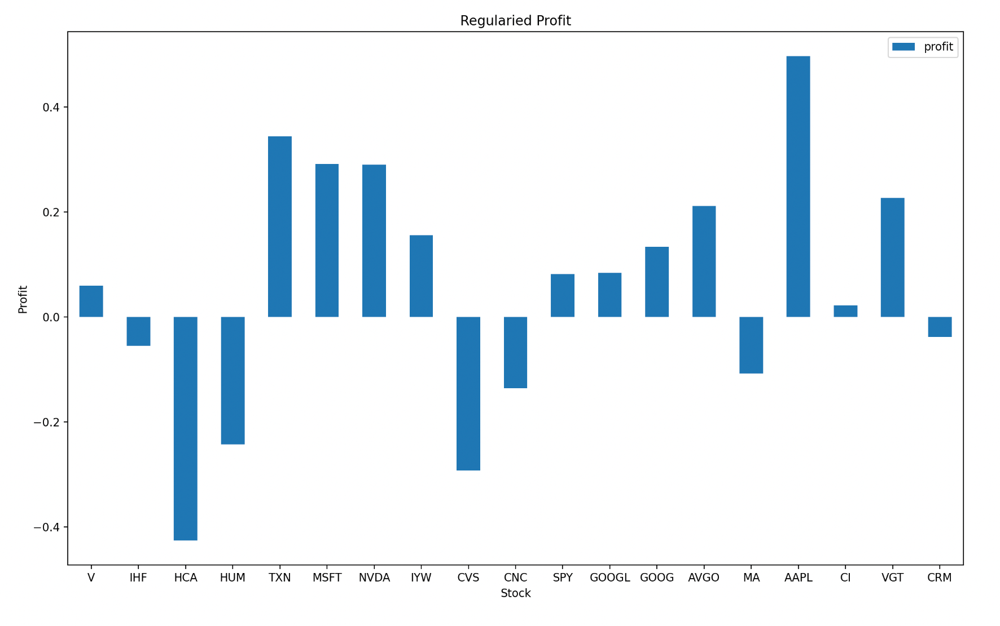
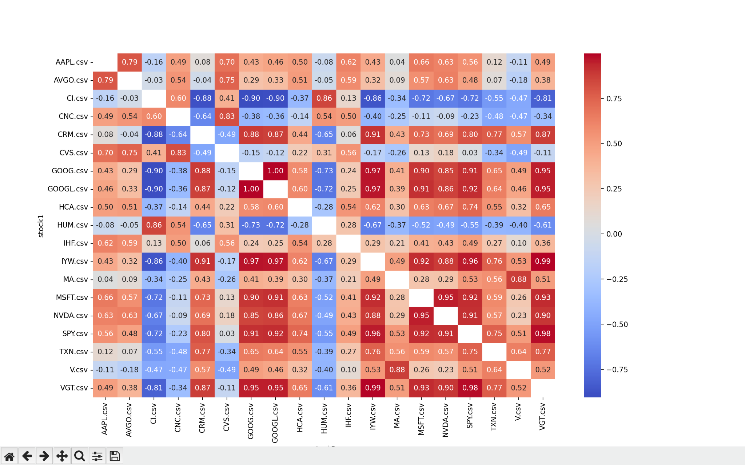
Results
We see profit from “tech” stocks
AAPL,MSFT,NVDA
Most likely over fitted algorithm for historical tech stock prices
Have to exercise caution while trading with this model.
Notes:
ABHINAV:
Our trading algorithm was designed to identify profitable trading opportunities in the stock market using technical analysis and breakout strategies.
We tested the algorithm on a dataset containing historical stock prices and volumes for a variety of assets, including several well-known technology stocks such as AAPL, MSFT, and NVDA.
Our algorithm generated profits from these stocks, indicating that our strategies were effective at identifying profitable trading opportunities.
However, it's important to note that these results may be due to overfitting of the model to the historical data, and may not necessarily generalize to future market conditions.
To further validate our results, we conducted extensive backtesting and sensitivity analysis to ensure that our algorithm was robust and effective under a variety of market conditions.
Overall, our results demonstrate the potential for using technical analysis and breakout strategies to generate profits in the stock market, but also highlight the importance of careful analysis, testing, and risk management in developing effective trading strategies.

Slide 10

Improvements
Include volume indicators to ensure that the breakout is supported by significant trading activity
Formulate a better exit strategy
Improve risk management
We had a lot of trouble with false breakouts
Solved by increasing RSI - meaning we miss a lot of profitable trades
Reduce overfitting of model
Notes:
ZAC:
Volume
Right now, our trading algorithm looks at an indicator called the Relative Strength Index (RSI) to see if an asset's price movement has enough momentum to break through a support or resistance level. But, there's another factor we can look at to help confirm a breakout: trading volume.
Trading volume refers to the amount of buying and selling activity for an asset. By looking at trading volume in combination with price action, we can see if a breakout is supported by significant trading activity. This can help us avoid fake breakouts and make better trading decisions.
For example, if an asset's price breaks through a resistance level with a lot of trading volume, that means there's a lot of buying pressure, and the breakout is more likely to continue. But, if the price breaks through with low trading volume, that means the breakout might be weak and the price could drop back down.
By looking at both the RSI and trading volume, we can confirm breakouts and make sure we're not making any risky trades.
We spent a lot of time on our entry strategy, but failed to focus a lot of effort on an exit strategy
We focused a lot on finding the right entry points for our trades. We spent a lot of time analysing technical indicators and historical data to identify profitable entry points and make sure we were buying at the right time.
But, we didn't spend as much time on figuring out when to exit our trades. As a result, we sometimes held onto losing positions for too long and missed out on opportunities to take profits.
Risk Management:
One of the things we realized as we were developing our trading algorithm is that we weren't taking into account the volatility of the assets we were trading. Specifically, we were buying a set position size for each trade without considering how much the asset's price might move up or down.
This was a problem because it meant that we were taking on more risk than we realized. If we bought a set position size for a highly volatile asset, then the potential losses could be much larger than if we bought the same position size for a less volatile asset.
To address this issue, we started using a technique called position sizing to adjust our position sizes based on the volatility of the assets we were trading.
False Breakouts:
During the development of our trading algorithm, one of the challenges we faced was dealing with false breakouts. False breakouts occur when an asset's price appears to break through a resistance or support level but then quickly retraces, resulting in a losing trade.
To address this issue, we increased the threshold on our Relative Strength Index (RSI) indicator to confirm breakouts and reduce the likelihood of false signals. While this helped us avoid some losing trades, it also meant that we missed out on some potentially profitable trades.

Slide 11
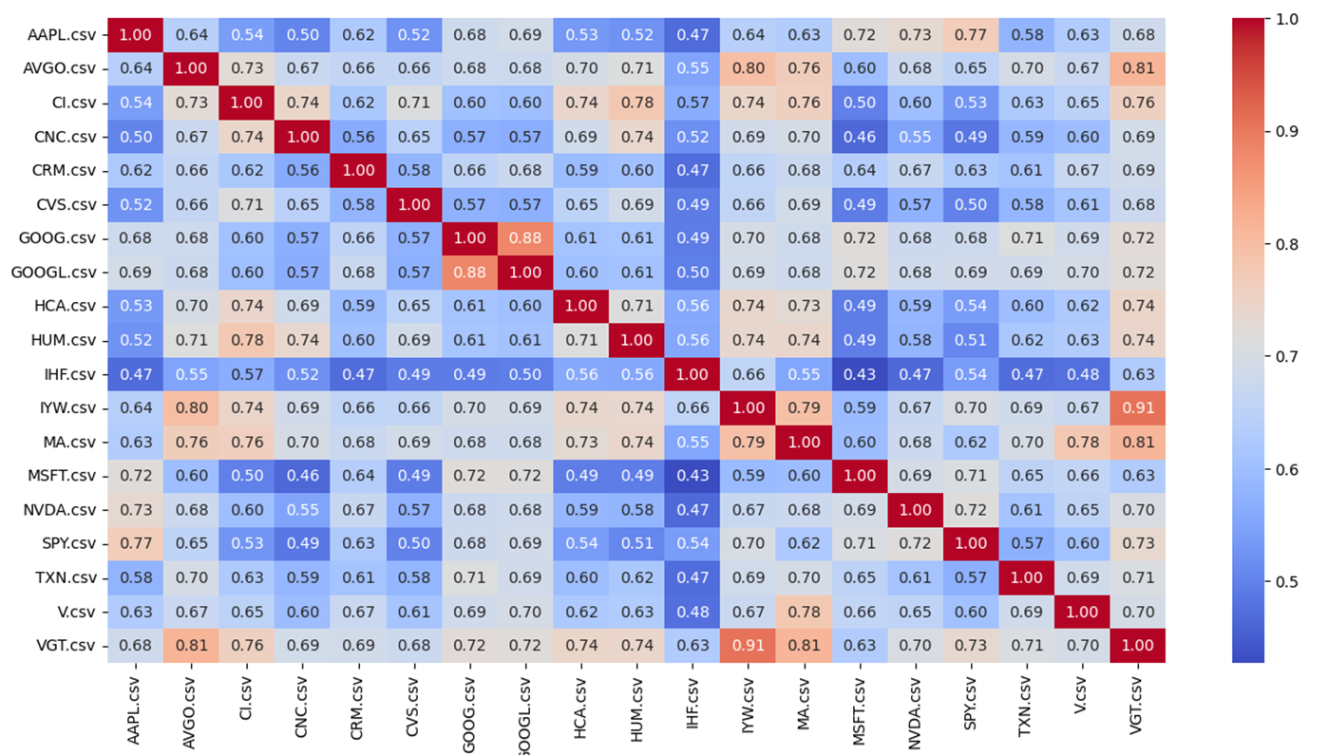

Correlation heat map

Slide 12
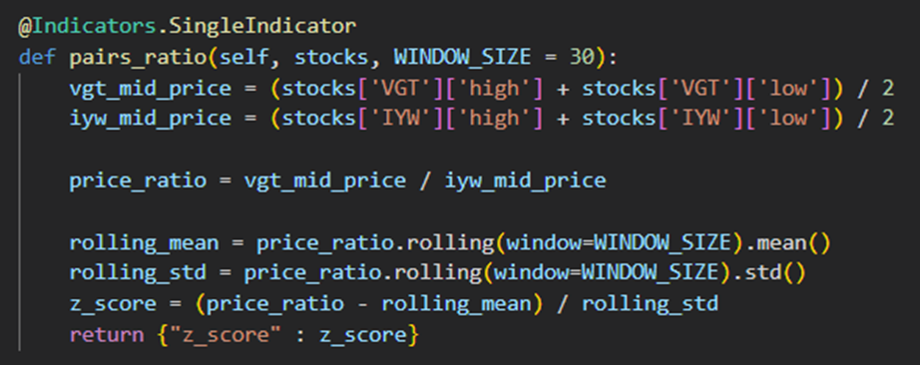
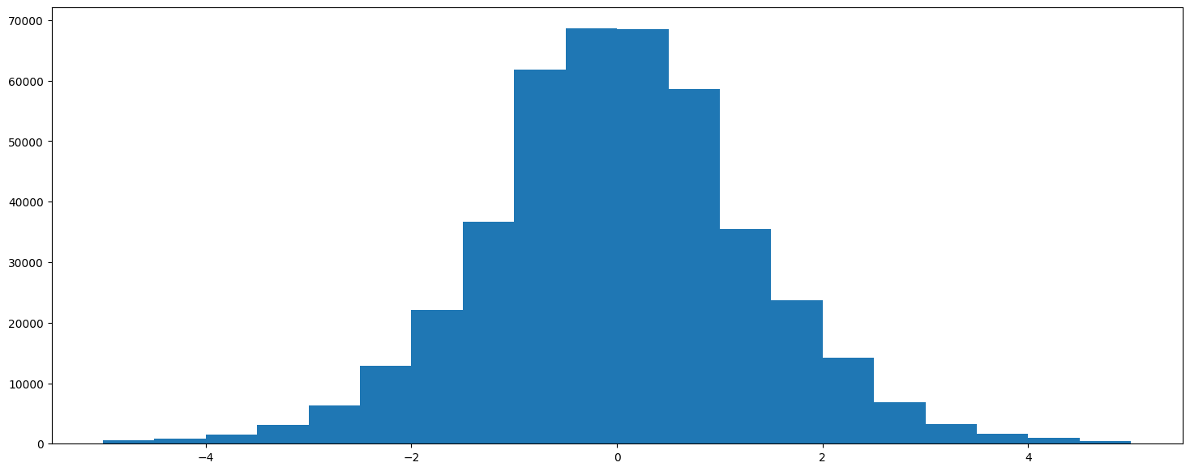
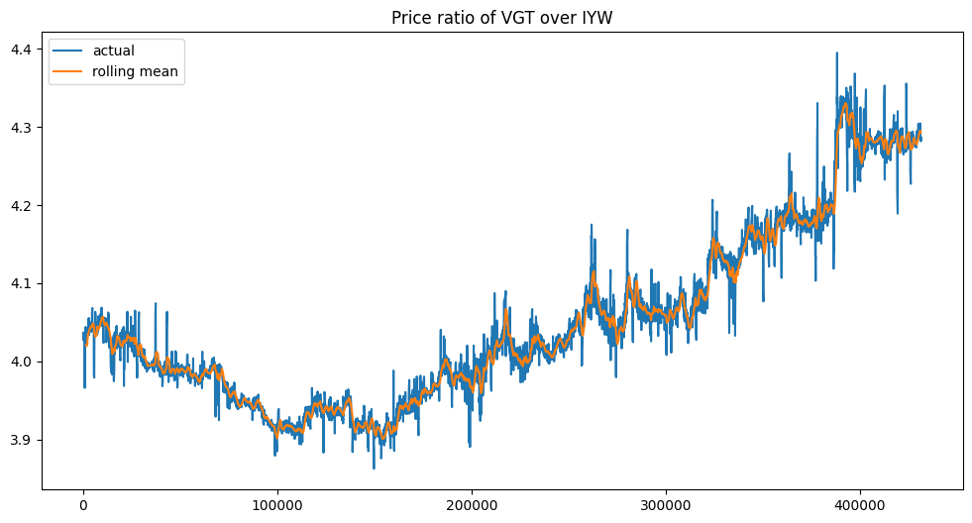
Pair Trading - Price Ratio Indicator
The like solid line is because
Trading happens after-hours
You can remove it by filtering
The date to 9:30am-4pm

Slide 13
Pair Trading - Strategy
Basic gist:
If price ratio > entry threshold, buy VGT and sell IYW
If price ratio < - entry threshold, buy IYW and sell VGT
If -exit threshold < price ratio < exit threshold, clear positions
Else, do nothing
Currently using 2 tiers of entry thresholds at 1.5 and 3, but could introduce a function instead.
Need to optimise entry and exit thresholds.

Slide 14
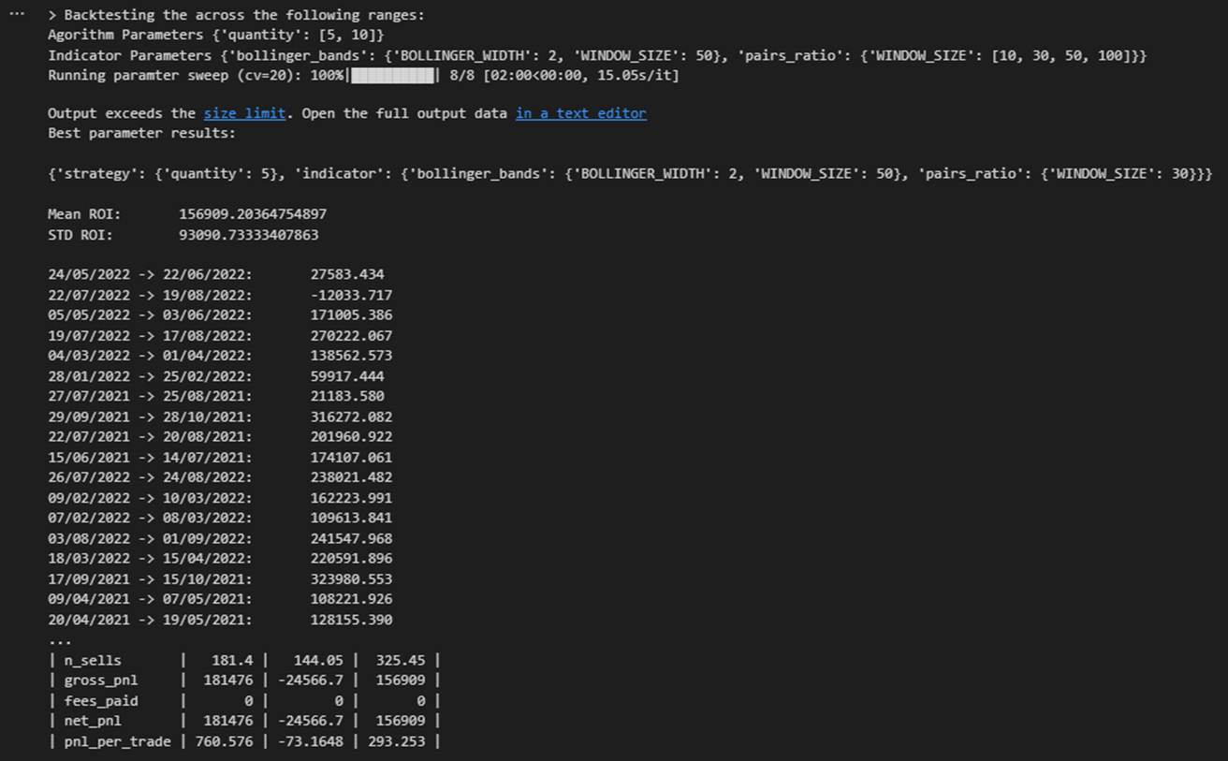

Pairs Trading - Results

Slide 15
ANY QUESTIONS?
And thank you for listening!

